Slide 1


SAP UI5 & FIORI with OData TRAINING using BAS
Anubhav Oberoy
Day – 5

Slide 2

Agenda – Day 5
Changing the default Model at run time
Element Binding
Event Object concept
What is Resource Model.
Steps to create a Resource Model.
Formatter
How to create a formatter
Using the predefined Formatter Classes
User Experience V/S User Interface
UI5 vs Fiori
What is Fiori?
Structure of Fiori App
Introduction to Component.js File

Slide 3
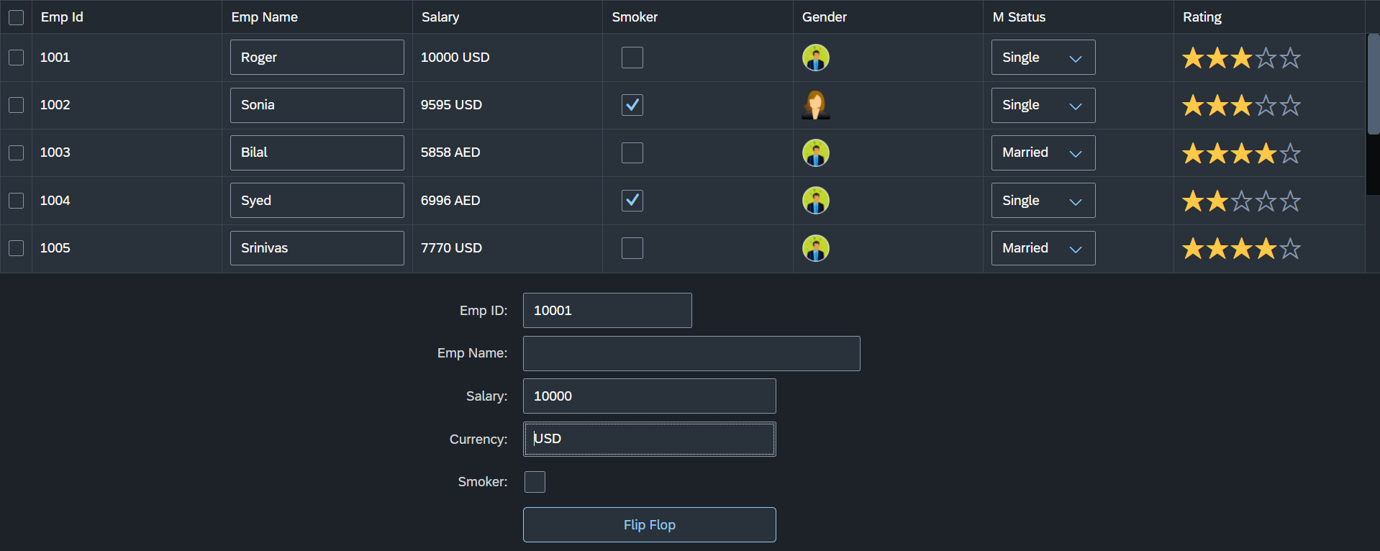
Hands – on: Changing the default Model
Now we will change the default model in in the application on press of a button in the ui.
For this we will create a Flip button on the ui the default model bind to the application will be changed every time. (Flip Flop).
Along with that we will set the Visible number of rows in the Table to 5.
Code Links:-
Main.controller.js
Main.view.xml
dataset.json

Slide 4



















Slide 5
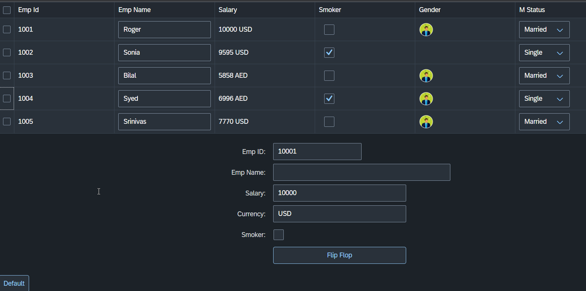


















Slide 6
Element Binding
To Understand the element binding first we have to understand about the what is element.
Element : Data related to the table inside the model memory is called as element ,
so, if we have 10 elements in the model we will get eventually 10 rows in table at runtime.
“empTab": {
"empId": 1,
"empName": "Roger",
"salary": 10000,
"smoker": false,
"currency": "INR",
"mStat": "S",
"rating": 2
}, ,
{
"empId": 2,
"empName": "Ananya",
"salary": 20000,
"smoker": true,
"currency": "INR",
"mStat": "S",
"rating": 4
}
Id | Name | Salary
1 | Roger | 10000
2 | Ananya | 20000
Element 0
Element 1

Slide 7
Element Binding continues..
Element binding is useful for containers and layouts containing other controls. All these child controls would be required to use properties of the same model object or model node, then element-binding is preferable.
An element to be bound to an object in the Model can be achieved by Element binding.
Use case:- On Select of a row in the table show the row data in a form.
The path of the element will always be the :
/entitysetname/index of the element
Table
Emp Id | Emp Name | Salary
{empId} | {empName} | {salary}
Element 0
/empTab/0
/empTab/1
/empTab/2
Element 1
Element 2
Simple Form
Field 0
/empId
All the content of Row 1 in the table is bind to all the fields in the form
Field 1
/empName
Field 2
/salary

Slide 8
Event Object Concept
Every UI5 event handler method will be entitled to receive an object free in the function, this object is know as event object.
This object is responsible to carry important information about the event.
For example : the rowSelectionChange event’s event object will let you know about the index of the row selected by the user.
Every Event object in SAPUI5 have exact 3 same function which are generic :
getSource() : will give the object of the source control from where event was originally generated. We can get object of the control, we can use it without giving an id.
getParameters() : every event carries a lot of the information about the user action e.g. row index of the selected row of the table. All this info come in form of parameters.
getParameter() : if we want to get single parameter value we can get it using this getParameter() function.
Note : best practice to use event object is put oEvent in the function’s parameter and using a hard debugger and then check the information got by the event object in browser’s console.

Slide 9
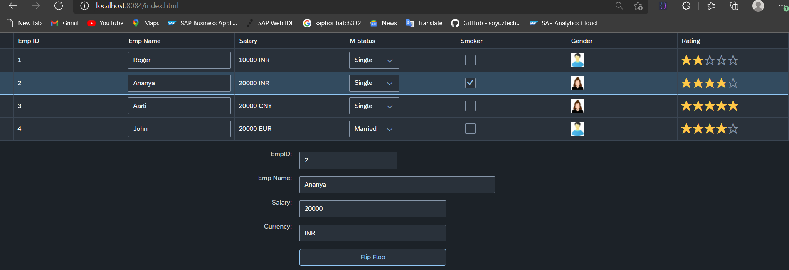
Hands – on: Element Binding
Make the table rows from multiselect to single select.
On select one row the data of that row have to shown in the SimpleForm by using the event object and element binding discussed in the previous slides.
Code Links:-
Main.view.xml
Main.controller.js

Slide 10
Resource Model
We build software for international audience, we cannot just hardcode every screen element in English, if it requires multi-lingual support, we need to add resource model.
i18n → Internationalization : Make the app available for international usage, which means supporting multiple languages.
There are 2 job roles in the process:
UI5 Consultant
Language Expert KM
?sap-ui-language=hi
Implement the model to provide support for internationalization
Translate the texts to provide support in multiple languages
I18n.properties
TEXTS
Language specific

Slide 11
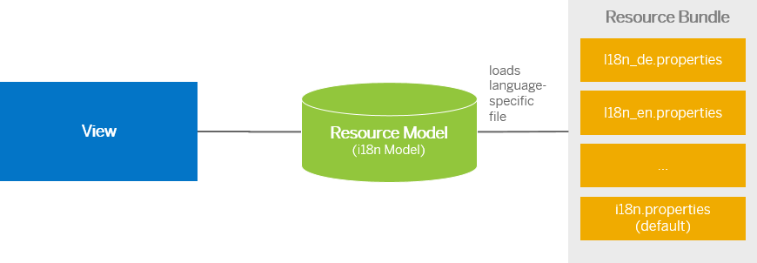
Steps to Create a Resource Model
Create resource bundle which includes label field
Create a folder i18n and inside this folder the file named i18n.properties for default labels.
And i18n_langcode.properties for different languages
Set The model
For more information about i18n you check the link
https://openui5.hana.ondemand.com/1.34.9/docs/guide/831039835e7c4da3a8a0b49567573afe.html
We can change the language of the app by adding ?sap-language=language_code at the end of the URL of the app. Example for Hindi we will write ?sap-language=hi

Slide 12
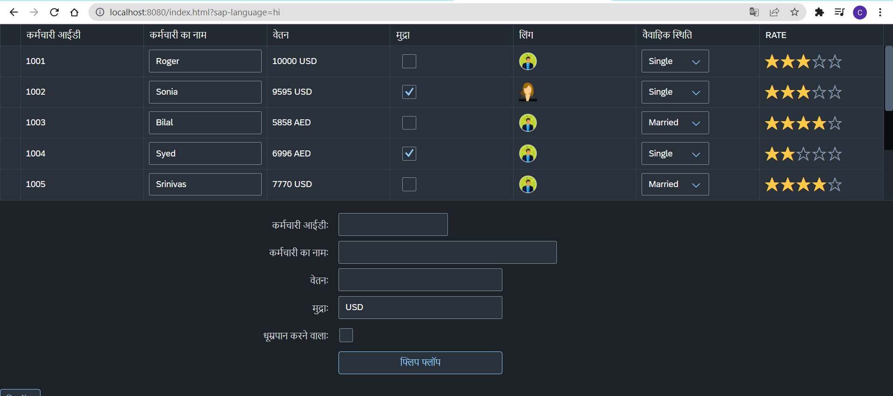
Hands – on: Resource Model
Now we will see how the language of an app is changed using the i18n file.
We have to create a folder ‘i18n’ in webapps folder and in the folder, we have to add files named ‘i18n.properties’ and one another file named according to the language we want. For example:- for Hindi language the file is named as ‘i18n_hi.properties.
Code Links:-
Main.view.xml
Main.controller.js
model.js
i18n.properties
i18n_hi.properties

Slide 13
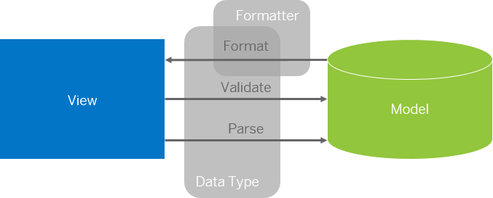
Formatter in SAP UI5
Formatters are used to define the formatting of data on the UI while data types work in both directions: they format the data on the UI and parse and validate user input that is entered.
Formatter is a function; This function gets called JUST Before the binding takes place with the view.
Formatter file is placed in a folder in webapp folder, and the file can be named anything with the .js extension.

Slide 14
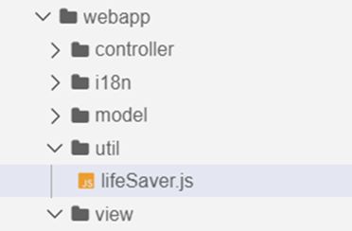
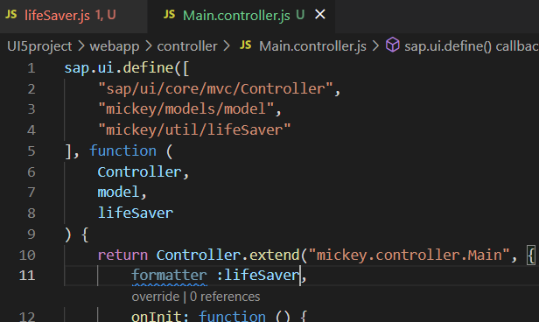
How to create a formatter
To create a formatter first create a utils or util folder inside the webapp folder.
Now create a file lifesaver.js inside the util folder .
Inside the file (lifeSaver.js) create the function(convertUC) for formatting.
After creating this function , inside the controller include it as a dependency and create a global variable at controller level which is accessible in the current view.
Now bind the formatter inside the view by using the second property binding syntax.
{path: ‘ ’ , formatter : ‘.formatter.formatterFunction’}
Formatter
The first dot represent that the it is in the controller

Slide 15
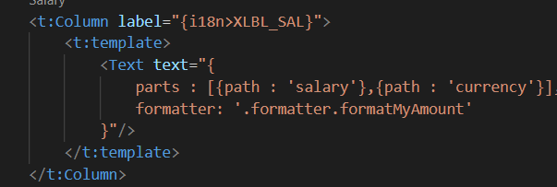
How to create formatter continue….
When we there are two fields bind in one
for e.g:
Here we have to bind in a little different format and the format will be
“{ parts : [{path : ‘salary’},{path : ‘currency’}] , formatter : 'formatter.formatterfunction’ }”

Slide 16
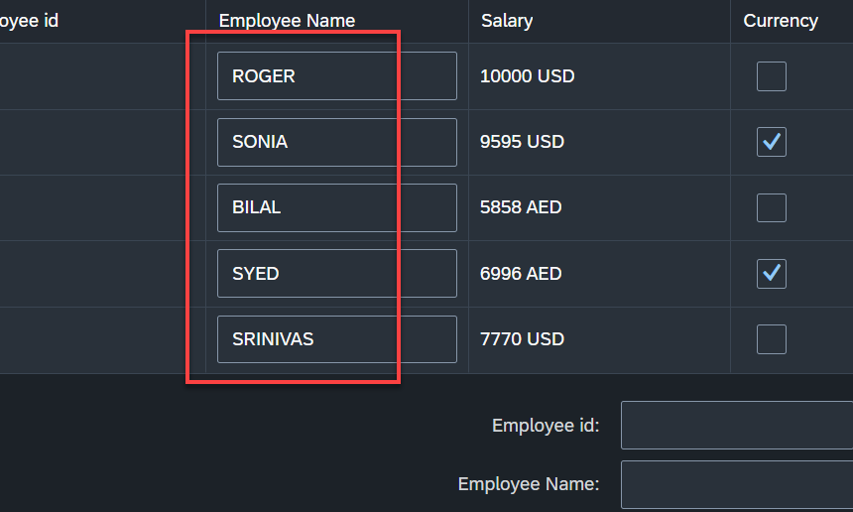
Hands – on: Formatter
Now Create a formatter to format the employee name in table to uppercase.
Code links:-
Main.view.xml
Main.controller.js
lifeSaver.js

Slide 17
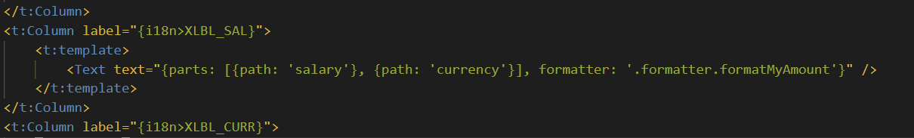
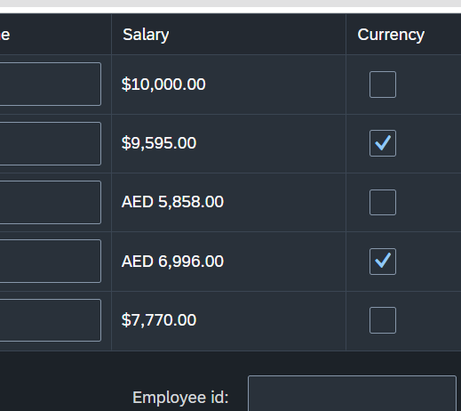
Hands – on: Currency Formatting
Now we will see how to use the sap provided formatter classes to format the data in the UI.
For this exercise we will use the “sap/ui/core/format/NumberFormat” class to format the currency.
Code Links:-
Main.view.xml
lifeSaver.js

Slide 18











Slide 19
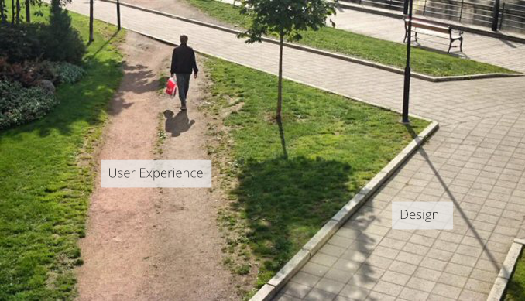
User Experience v/s User Interface
UI stands for user interface but UX stands for User Experience
UI is technical view point of our application interface which will be used to take and provide information to the user but UX is psychological and emotions of the app.
We can change the UI but we cannot change UX
Take an example of modern world of apps, where no one needs to give you training to use amazon, uber, eBay etc.
User interface is developer oriented. This is purely technical. We can change UI any number of times.
User experience is user oriented. It is psychological. We cannot change UX.

Slide 20
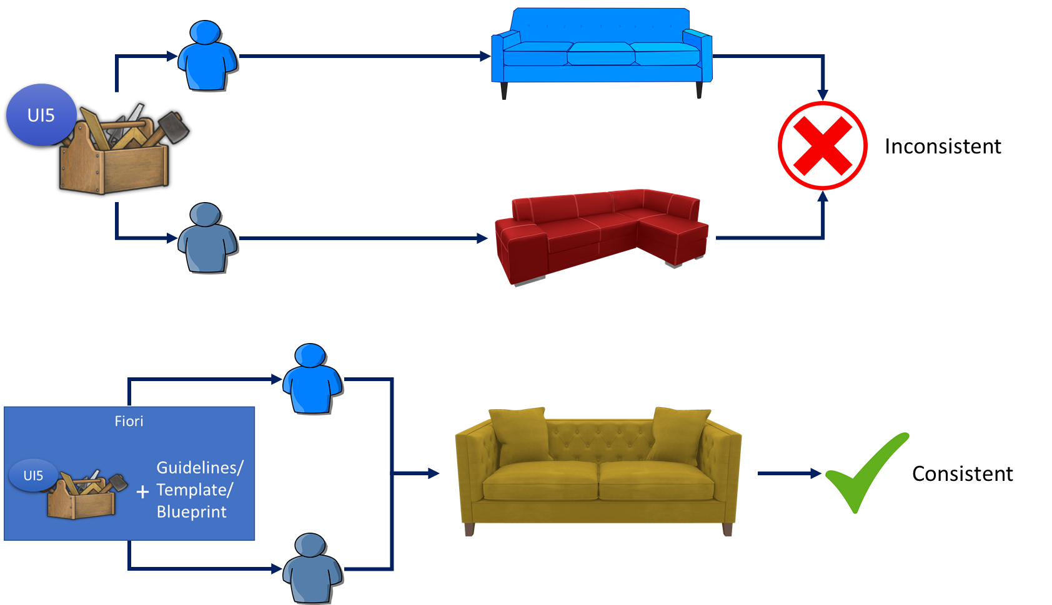
UI5 V/S Fiori
SAPUI5 is used to design UI but SAP Fiori is used to create User experience. Fiori apps are technically built on SAP UI5 only but they follow guidelines which are provided by sap and proven golden path for development of apps.
SAP Fiori provides also the pre-defined templates like master details, object list page, worklist etc. which brings our UI more closer to User experience.

Slide 21
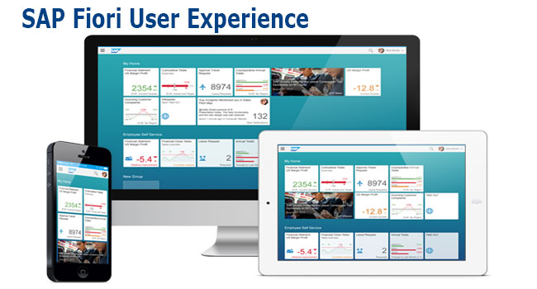
What is Fiori?
SAP Fiori is the user interface or user experience (UX) that supplements and can replace the SAP GUI. This streamlined application uses tiles to encapsulate standard tasks, such as approving purchase requisitions, viewing sales orders, and approving timesheets.
Fiori is SAP’s new user experience. These are standard apps delivered by SAP and by following the Development guidelines any one can use UI5 to create Fiori Apps.
Fiori is a streamlined application, delivering a role-based user experience that can be personalized across all lines of business, tasks and devices.
It uses tiles to encapsulate standard tasks like viewing sales orders or approving timesheets.
Fiori = UI5 + Development/Design Guidelines

Slide 22
Structure of a Fiori App
There are different folders and directory are required for setup project: webapp, Controller, models, utils ,view, Component.js, manifest.json, index.html
Structure of normal ui5 application
Index.html
View
Controller
Structure of Fiori Application
Dev.
sap/ui/core/UIComponent
Index.html
Root View
App.view.xml
Component.js
View 1
Controller 1
Container
App (pages)
View 2
Controller 2
manifest.json
App descriptor
App.controller.js
BaseController
Component.js is starting point

Slide 23
Component.js File
Component.js the starting point of all Fiori applications, it is used by Fiori Launchpad to kick-start our app. If an app has Component.js inside, it called Fiori like app.
We will decouple everything from index.html to avoid user starring app w/o launchpad because of security rick of user opening app direct from index file.
It is the wrapper of all the functionality.
The name of the file must be, must be Component.js
It should ideally be created inside the webapp folder
If our app does not have Component.js, we will not be able to integrate our app with launchpad
It is a class which inherits from sap/ui/core/UIComponent standard class. We inherit to reuse the functionality offered by SAP like routing.
When app starts, UI5 framework will scan your project’s base directory to check if it has a file with exact name Component.js
The component file calls the manifest file, and we keep all app level configuration inside the manifest file.

Slide 24
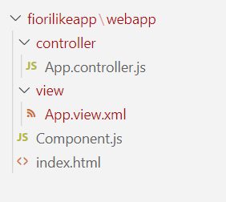
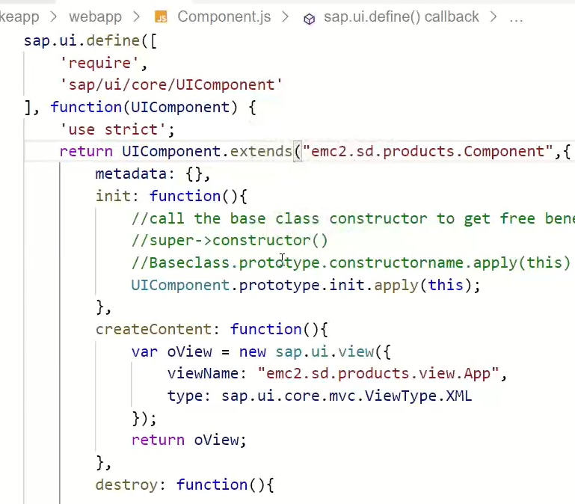
Hands – on: Create our first Fiori Like app
Create a new folder named fiorilikeapp in our projects directory, using the command mkdir fiorilikeapp.
Now navigate to the newly created folder using the command cd fiorilikeapp, and then create a webapp folder inside this newly created folder using the command mkdir webapp. Then move inside this folder using command cd webapp.
Now create two files in the webapp folder using the commands touch index.html and touch Component.js
After this create a App view and App controller in the respective view folder and controller folder.
Once the files are created paste the code from below links.
Code links:
index.html
Component.js
App.view.xml
App.controller.js
Namespace naming convention: “company.area.project”
Example:
ibm.fin.ar
emc2.fin.ar
ibm.hr.payroll
ibm.fin.ap

Slide 25

End of Day 5

Slide 26

Questions

Slide 27

Anubhav Oberoy

Slide 28


We’re committed to empower you to be
Most Desirable Resource
through powerful training solutions.
We build the workforce of the future.
250+
Corporate Clients
30,000+
Learners Trained
25000+
Learners Placed
FREE WEBINARS
Sign up for free webinars with industry experts every fortnight!
Enroll Now!
Contact us today!
https://anubhavtrainings.com/

Slide 29




More from AnubhavTrainings.com

Slide 30
Title
Content

